Slide 1
Software engineering
Section 3

Slide 2
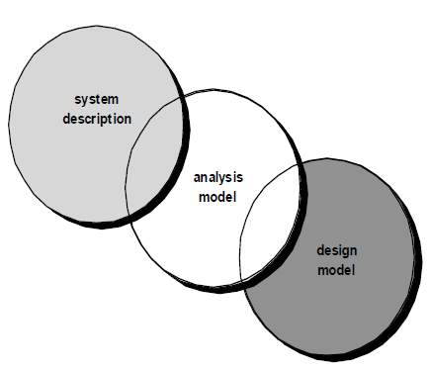

Slide 3
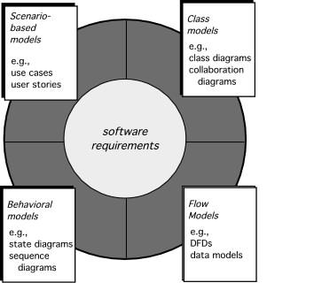
Elements of Requirements Analysis

Slide 4
Scenario-based Model

Slide 5
Scenario-based elements
Functional—processing narratives for software functions
Use-case—descriptions of the interaction between an “actor” and the system

Slide 6
User cases
Use cases describe how a specific user category (called an actor) will interact with the system to accomplish a specific action.
Benefits:
Use cases provide the detail necessary for effective planning and modeling activities.
Use cases help the developer to understand how users perceive their interaction with the system.
Use cases help to compartmentalize software engineering work.
Use cases provide important guidance for those who must test the software.

Slide 7

Actors
An Actor is outside or external the system.
It can be a:
Human
Peripheral device (hardware)
External system or subsystem
Time or time-based event
Represented by stick figure

Slide 8
use case
A use case is a summary of scenarios for a single task or goal.
Represented by an oval

Slide 9
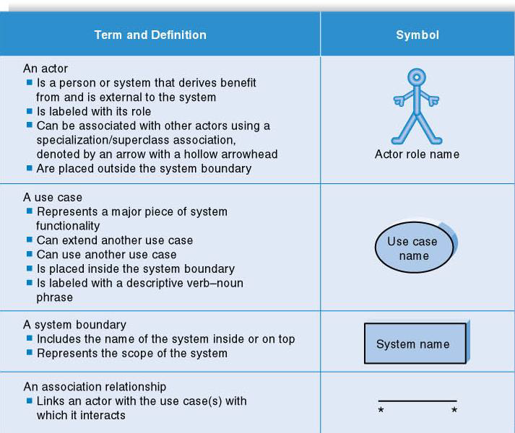

Slide 10
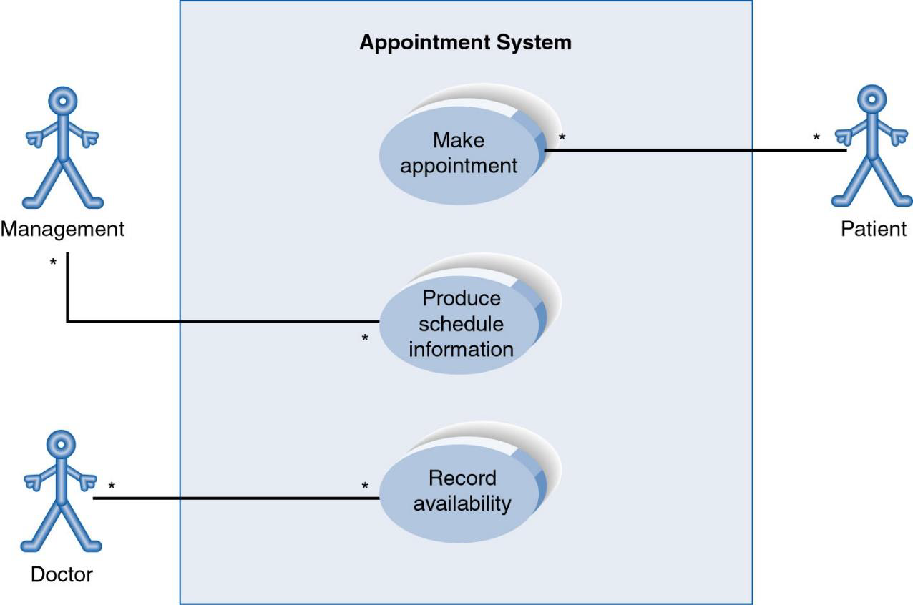
Use-CaseDiagram

Slide 11
Chaos Report
Other Types of Relationships for Use Cases
Generalization
Include
Extend

Slide 12
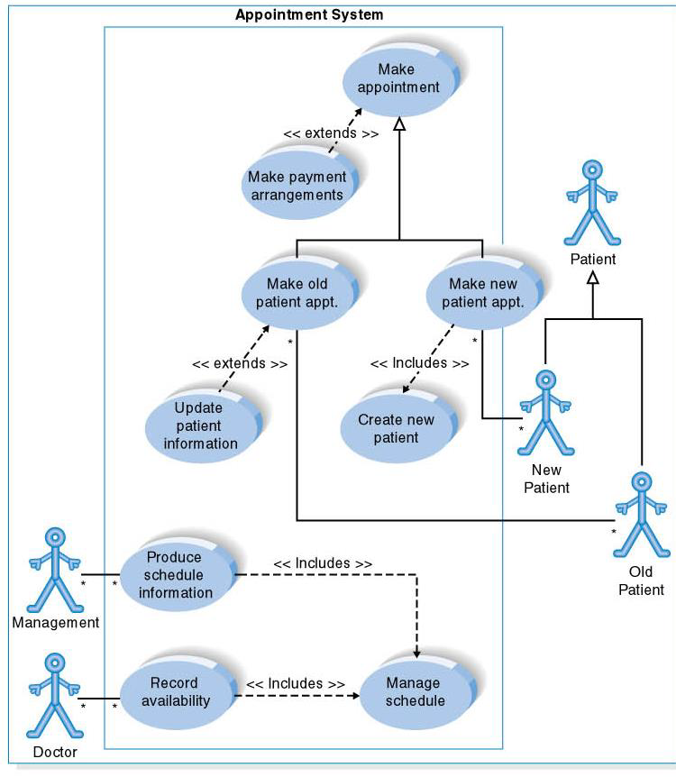

Slide 13
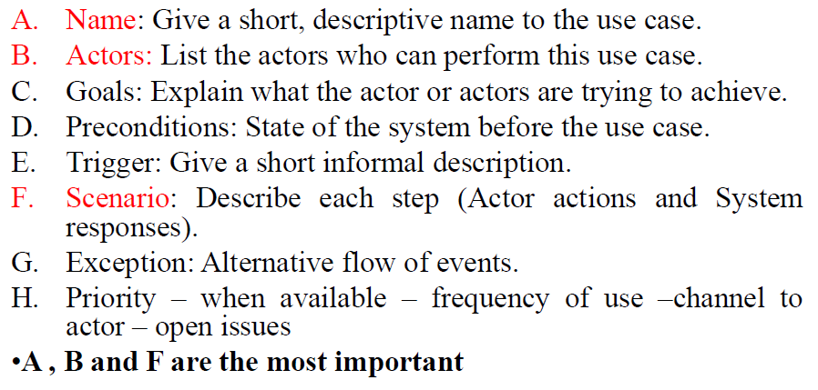
How to describe a single use case

Slide 14
Visual Paradigm

